Slide 1

Title of your Project
PASSWORD MANAGER
Group members with StudentId
Shweta Bhutada 21104007
Manjiri Gole 21104006
Akshata Nalavade 21104003
Project Guide
Prof. Mansi Choche

Slide 2
Contents
Introduction
Objectives
Scope
Features / Functionality
Project Outcomes
Technology Stack
Block Diagram/ Flow

Slide 3
1. Introduction
A password manager allows individuals and businesses to save and manage all their passwords from one safe space.
Problem Faced By Users:
Since users have to create their own passwords, it is highly likely that they won’t create a secure password.
Often, users tend to use similar passwords across different networks and systems which makes their passwords vulnerable to hacking.
A common way for attackers to access passwords is by brute forcing or cracking passwords.
Solution:
We use password manager so that we can save and store multiple passwords in one safe place.
We would use a master key that will give us access to all our passwords.
We can use it as it is available across different platforms and devices, making password manager hassle-free.

Slide 4
2. Objectives
Main objectives of a password manager are:
1. One master key to access your credentials.
2. Share and store passwords securely.
3. Autofill your passwords.
4. Access all of your accounts.

Slide 5
3. Scope
Safe and Secure: Reliable password managers are very hard to hack. Strong encryption is offered by password managers, acting as a powerful deterrent to online criminals.
Easy accessibility and managing : Logging onto accounts is simple. You can also launch websites directly from the password manager instead of navigating to the site yourself.
One master password to access your credentials: A password manager stores all of your passwords in a single vault using one strong master password. The master password is the only password you will need to remember to access your vault.

Slide 6
4. Feature /Functionality
Ability to encrypt passwords and other confidential data with industry-standard encryption like aes-256,md5,sha2 .
Password managers keep sensitive information private and secure, helping to protect users' privacy online.
Password managers can analyze your passwords and identify weak passwords

Slide 7
5. Outcome of Project
Simple and intuitive interface, making it easy for users to get started
Auto-fill features make it easy to log in to websites, saving time and reducing the risk of typing errors.
Encourage users to create strong, unique passwords and regularly change them, which is important for good password hygiene.
Enhanced privacy

Slide 8
6. Technology Stack
Write what you have planned to develop front end ( GUI ) & Backend (Database if applicable)
Python
MySQL

Slide 9
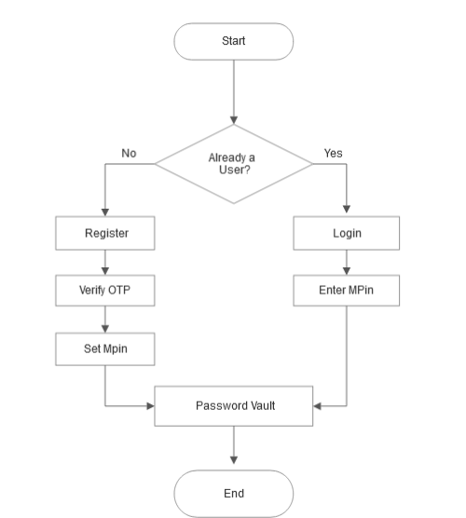
7. Block Diagram/ Flow Chart

Slide 10
Thank You...!!

